Slide 1

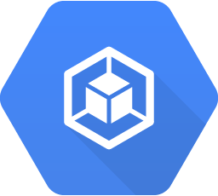
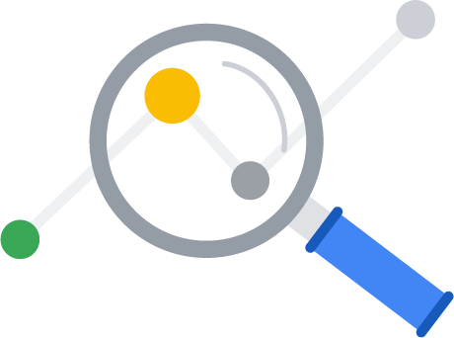
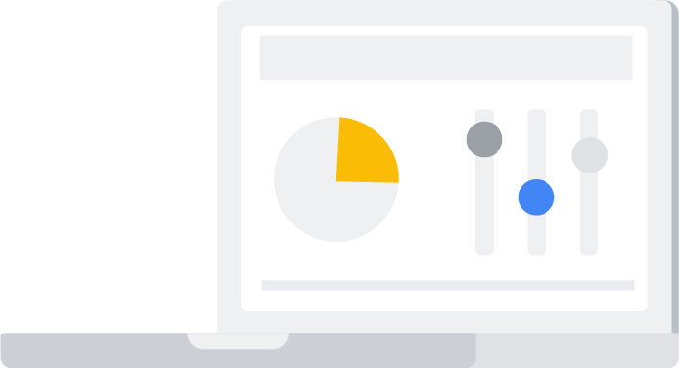
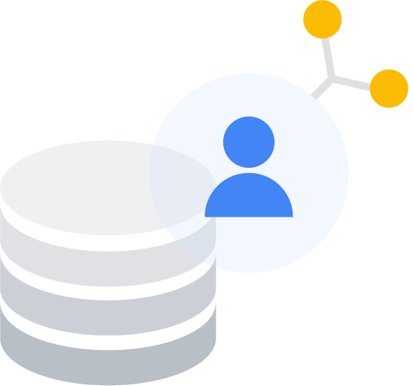
GCP Learning Series for Genpact
—
—
—
—
App Modernization | Site Reliability | Data & Analytics (I) | GCP AI Overview
Apr 27 | May 4 | May 19 | Jun 2
Intro to App Mod Kubernetes Anthos PowerMe Story | Best practices - DevOps and SRE DORA and CAMP Genpact story | Unified Data Platform BigQuery Deep-dive Dataplex | AI Overview Vertex AI ML Ops
Access to GCP labs Apr 27 - May 3 | Access to GCP labs May 4 - May 10 | Access to GCP labs May 19 - May 25 | Access to GCP labs Jun 2 - Jun 8
Office hours (30 min): Apr 28 May 2 | Office hours (30 min): May 6 May 9 | Office hours (30 min): May 20 May 24 | Office hours (30 min): Jun 3 Jun 7

